Slide 1
Drug Target protein interaction prediction by PSSM and LOOP method

Slide 2
TEAM MEMBERS AND GUIDE
C. Vijayabaskar
2017103048
G. Velmurugan
2017103047
K. Sathish Kumar
2017103588
G. Sudhakaran
Teaching Fellow
Department of Computer Science and Engineering
College Of Engineering Guindy
Anna University

Slide 3
INTRODUCTION
Drug-Target Interaction Prediction (DTI) is an important application of machine learning in medicine industry, the importance is coming from the fact that we need to save the time and cost of the drugs development.
Computational methods for DTI prediction are divided into 3 main approaches:
Ligand based
Docking simulation
Chemogenomic

Slide 4
OVERALL OBJECTIVES
The main objective of the project is to predict the interaction of drug and target.
It uses the Chemogenomic approach of predicting the interaction.
The method combines local optimal oriented pattern (LOOP), position specific scoring matrix (PSSM) and rotation forest (RF) for predicting DTIs.

Slide 5
LITERATURE SURVEY
Nidhi proposed a multiple-category Laplacian modified naïve Bayesian model to train 964 target categories in the (World of Molecular Bio Activity) WOMBAT database and predicted the top three most potential compound targets in the MDDR database.
Liu proposed a novel prediction algorithm, namely neighbourhood regularized logistic matrix factorization (NRLMF), which focus on predicting the probability whether a drug would interact with a target and also study local structure of drug-target pairs for further improving the accuracy of DTIs.
Wang developed a computational method which combines auto covariance (AC) and rotation forest for predicting potential drug-target interactions.
Mei developed a novel approach namely BLM-NII, which integrated neighbour-based interaction profile inferring (NII) into bipartite local model (BLM), the method achieved excellent improvement in inferring unknown drug-target interaction.

Slide 6
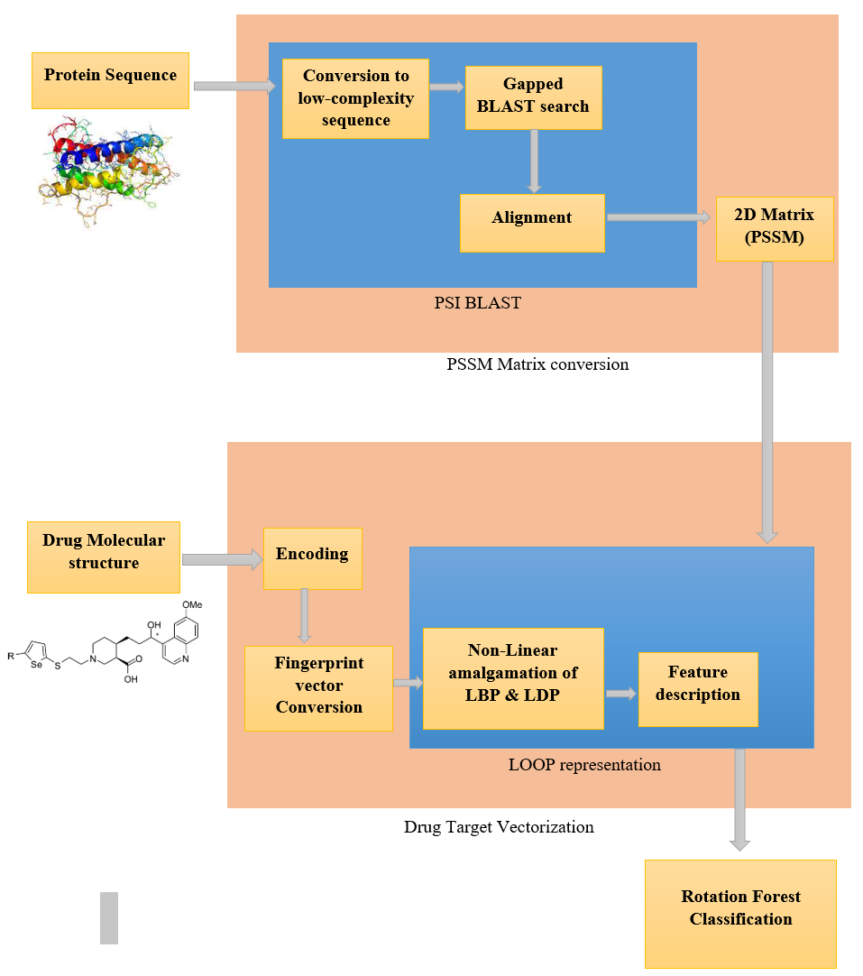
Block Diagram

Slide 7
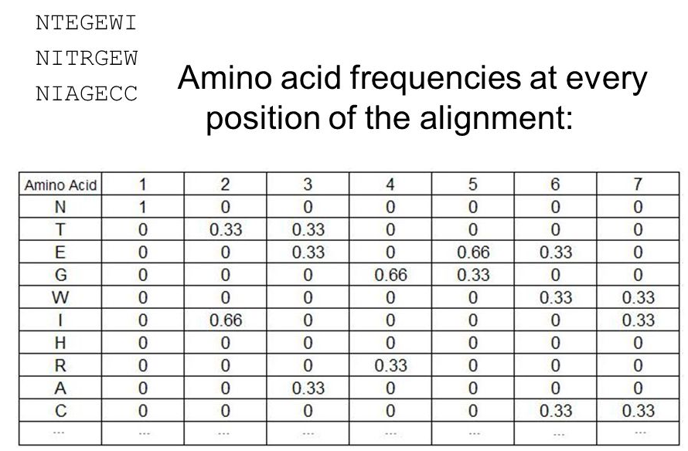
Details Of Module
PSSM Formation:
Position-specific scoring matrix (PSSM) is one of the descriptor which carries the evolutionary information of sequence and gives probability scores of any given amino acid for a specific position.
In order to convert the target protein sequence, the Position-Specific Iterated Basic Local Alignment Search Tool (PSI -BLAST) which can search and compare the homologous sequence of each target protein sequence is adopted to create PSSM of each target protein sequence.
PSI blast first scan for the presence of low complexity regions. The program then initially operates on a single query sequence by performing a gapped BLAST search.

Slide 8
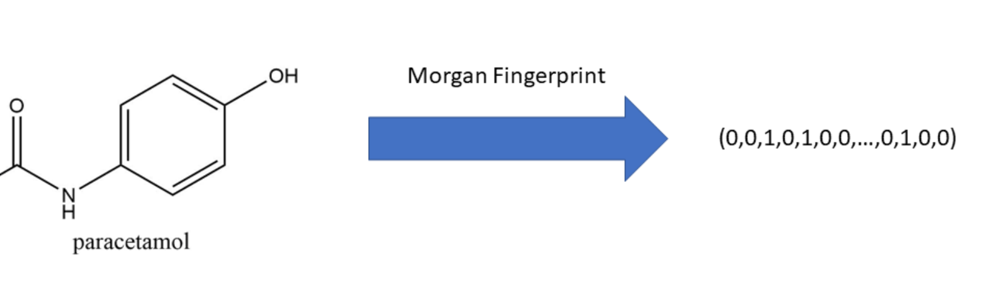
Details Of Module
Fingerprint Vectorization:
There have been proposed different kinds of drug compounds descriptors, such as constitutional, quantum chemical properties, topological and geometrical.
Moreover, the structure properties of the drug molecules were encoded in binary bits, which can directly know whether specific substructure fragments in the drug molecules exist or not.
It reduce the workload of molecular descriptor calculation and screening.

Slide 9
Details Of Module
LOOP Formation:
Local optimal oriented patterns texture descriptors which encode repeated local patterns in images as binary codes, and it is a popular type of feature used for classification in computer vision.
Because of the disadvantage of local binary pattern (LBP) and local derivative pattern (LDP) is the arbitrary sequence of binarization weights that adds dependency to orientation.
Thus, LOOP presents a nonlinear amalgamation of LBP and LDP that overcomes these drawbacks while preserving these strengths. Here, the input signal PSSM is a N x 20.

Slide 10
Details Of Module
Classification:
The Rotation Forest algorithm focuses on improving the difference and accuracy of the base classifier.
In this work, we adopt RF as a classification model for predicting DTIs.
Specifically, the RF randomly divides entire sample set into K subsets, and principal component analysis (PCA) method is adopted to transform the subsets which make the difference between each subset.

Slide 11
Perfomance measures
In order to evaluate the performance of the propose method, we use the evaluation measures such as the overall prediction accuracy (Accu.), sensitivity (Sens.), precision (Prec.), and Matthews correlation coefficient (MCC).
When predicting the DTIs datasets of enzyme, ion channels, GPCRs and nuclear receptor, five-fold cross-validation would be adopted in this work in order to avoid the over-fitting of the prediction model.

Slide 12
Dataset
In this study, we execute the experiment for predicting DTIs on four golden standard datasets, namely enzyme, ion channels, GPCRs, and nuclear receptor, respectively. These datasets are collected from DrugBank, KEGG BRITE, SuperTarget & Matador, and BRENDA which were considered as high-reliability databases.
Drugbank- https://go.drugbank.com/releases/latest

Slide 13
References
1. Xinkie Zhan , Zhu-Hong You (Member, IEEE), Jinfan Cai, Liping Li, Chanqing Yu, Jie Pan, and Jiangkun Kong “Prediction of Drug-Target Interactions by Ensemble Learning Method from Protein Sequence and Drug Fingerprint”.
2. Nelson R. C. Monteiro, Bernardete Ribeiro, Joel P. Arrais “Drug-Target Interaction Prediction: End-to-End Deep Learning Approach”.
3. Y. Yamanishi, E. Pauwels, and M. Kotera, ``Drug side-effect prediction based on the integration of chemical and biological spaces, Nov. 2012.
4. M. Kuhn, M. Al Banchaabouchi, M. Campillos, L. J. Jensen, C. Gross, A. Gavin, and P. Bork, ``Systematic identification of proteins that elicit drug side effects,'' Jan. 2013.
5. A. Ezzat, M. Wu, X.-L. Li, and C.-K. Kwoh, ``Drug-target interaction prediction via class imbalance-aware ensemble learning,''Dec. 2016.
6. S. M. Paul, D. S. Mytelka, C. T. Dunwiddie, C. C. Persinger, B. H. Munos, S. R. Lindborg, and A. L. Schacht, ``How to improve R&D productivity: The pharmaceutical industry's grand challenge,''Feb. 2010.
7. F. Zhu, B. Han, P.Kumar, X. Liu, X. Ma, X.Wei, L.Huang,Y. Guo, L. Han,C. Zheng, and Y. Chen, ``Update of TTD: Therapeutic target database,''Jan. 2010.
8. Y. Wang, S. Zhang, F. Li, Y. Zhou, Y. Zhang, Z.Wang, R. Zhang, J. Zhu,Y. Ren, Y. Tan, C. Qin, Y. Li, X. Li, Y. Chen, and F. Zhu, ``Therapeutic target database 2020: Enriched resource for facilitating research and early development of targeted therapeutics,'' Jan. 2020.

